Slide 1
Week3 AWS/DevOps

Slide 2
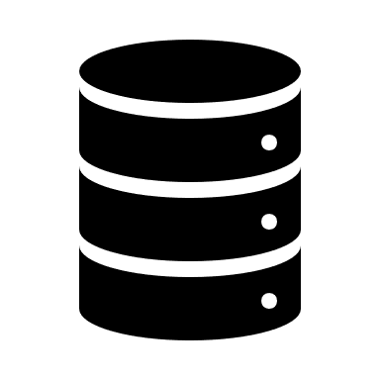
What we made last week
Server/ API

Slide 3


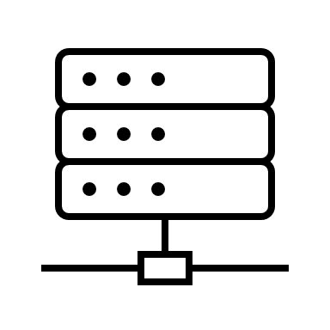
Right now…
Setup hardware
Install JRE/JDK
Install tomcat
Setup/configure db
Get files on server
App.war
App.war

Slide 4
The Cloud
App.war

Slide 5
Cloud vs on premise
Cloud
  Not your responsibility to manage the hardware
  Considered as more cost effective…
    Short term
    Scaling
    R&D
    Saving cost on personnel because cloud is “faster” to setup/ you don’t have to hire a team to do it
  Risk Averse
  Fault Tolerance – handling variable load/ multiple locations
  Resource Scaling/ Load Balancing/ Auto Scaling
  Easier to setup
  Easier to establish global infrastructure for latency, caching, etc.
  User friendly tools from Cloud Service Providers: AWS, Azure, GCP, etc.
On Premise
  Have more control
  Considered as more cost effective…
    Potentially cheaper for long periods of time
  Higher understanding of underlying process
  More Secure… if you do it correctly
  Dedicated host

Slide 6
AWS

Slide 7
Cloud Computing Platforms
IaaS (Infrastructure as a Service)
  Hardware is Abstracted
  Meant to be used by Sys. Admin. + DevOps engineers
PaaS (Platform as a Service)
  Hardware + environment is abstracted
  Developers
SaaS (Software as a Service)
  Hardware + environment + application
  End users

